Slide 1
Do you have intentions to create but find yourself starting, then stopping because your creativity is blocked? This workshop is for playwrights of both stage and screen who are looking to create believable characters, a strong storyline for either a short or a full- length script, and finishing with a script ready to be produced on stage and screen.
Are you an actor who audition but never get a call-back? It may not be your acting skills but your auditioning process. At this workshop you will learn how to ace that audition and get those jobs.
Do you want to add directing to your resume? Well, this workshop will have directors on hand for both stage and screen that can help you get to the next level.
If you are not sure exactly where you fit in and want to network with others in the arts, this workshop is for you. The final hour is set for panel discussions on playwriting, auditioning and directing, and networking with other locals.
Title: From Pen to Stage and Screen Workshop
When: Saturday, April 20, 2024 -- 9:00 am to 12:00 pm
Location: Montrose Community Center - 401 Branard Street - Houston, TX 77006
Fee: $20 ($15 for paid Scriptwriters-Houston Members)
https://www.paypal.com/donate/?hosted_button_id=H6VLHFWXRDHV4
Playwright for Stage: Fernando Dovalina
Screenwriter for Film: Margie Walker
Auditions: Ardencie Hall-Karambe’
Directors & Panel: Leslie Barrera / Mike Noel
If you have additional questions, please send them to scriptwriters.houston@gmail.com
Over

Slide 2
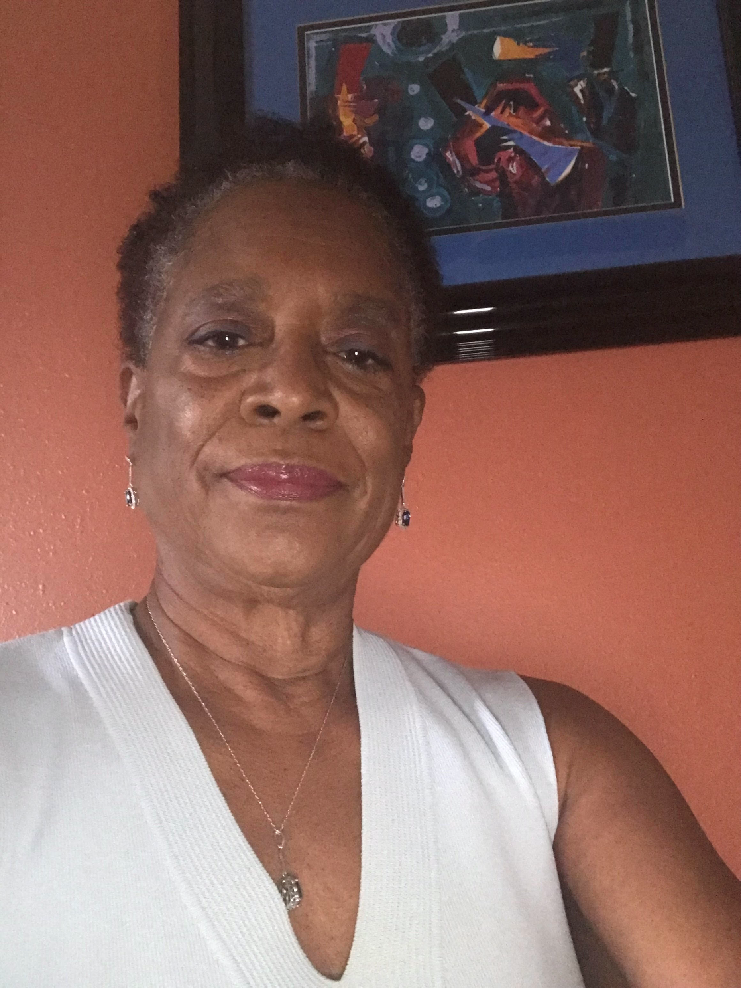
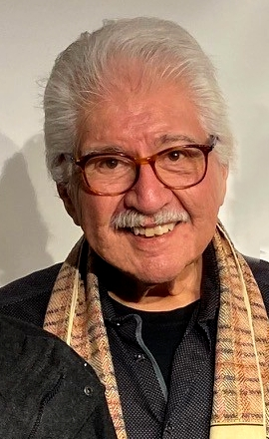
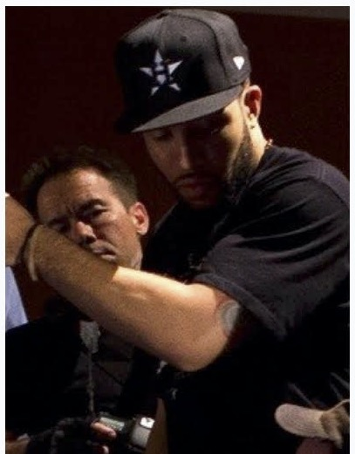
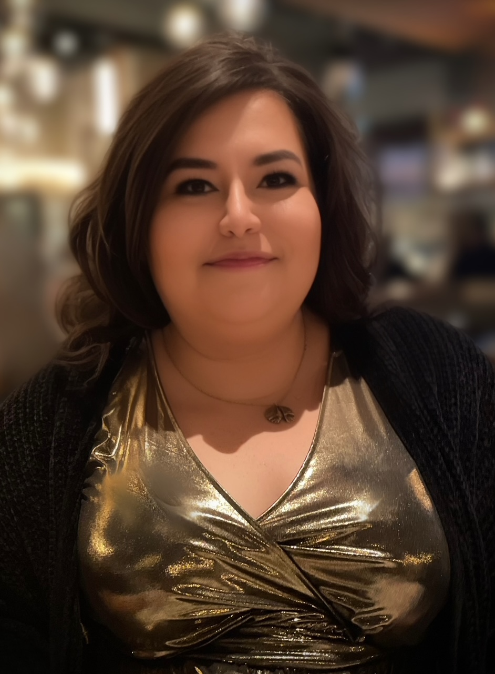
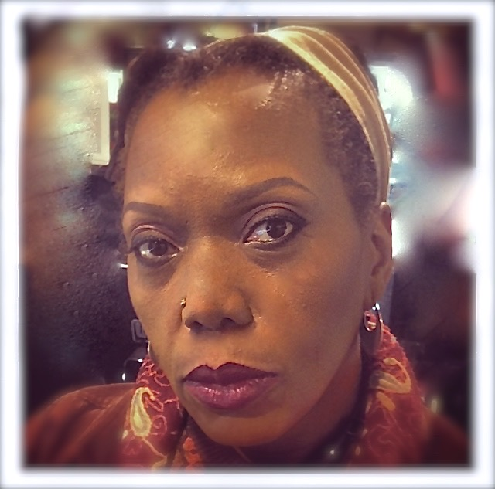
Margie Walker is an African American published author of romance, romantic suspense and mystery novels who has recently turned her hand to writing screenplays. Short screenplays TRYIN’ TIMES was a winner of the Moondance International Film Festival, while PLUM BLOSSOMS was a Second Rounder at the Austin Film Festival and a finalist at the San Antonio Film Festival. REPARATIONS, a Marcia Chenault-McKissack Mystery (based on the ebook A Slice of Reparations) won the mystery genre category of the Creative Screenwriting Unique Voices Competition. Walker is currently working on the second Marcia Chenault-McKissack mystery.
Fernando Dovalina, a member of the Dramatists Guild, is a graduate of the University of Texas at Austin with a degree in journalism. He worked for three Texas newspapers, including the Houston Chronicle, where he was an assistant managing editor in charge of the news and international desks. At the Chronicle, he won awards for his stories, and he supervised two projects that were finalists for the Pulitzer Prize. After retiring, Dovalina studied dramatic writing at Rice University with playwright Sam Havens; and at the University of Houston with Edward Albee, the award-winning playwright of “Who’s Afraid of Virginia Woolf,” who called Dovalina “a fine writer” and with Stuart Ostrow, the Broadway producer. Under Ostrow, he wrote the books for the first acts of two musicals, and they were produced at the Hobby Center. Dovalina has written more than 70 plays. Of his 11 two-act plays, five have been produced, “The Man in the Trunk,” “American Homefront,” “The Gospel According to Tammy Faye,” a musical for which he wrote the book, “The Comfort of Anger,” and “Eye of the Storm/Tales From Hurricane Ike.” Five others have received professional readings. In addition, three of his one-act plays have been produced; 17 of his short plays were produced as part of Scriptwriters/Houston’s “10 x 10.”
Mike Noel, CEO/Founder/Director/Writer/Producer
Throughout his life Mike Noel has been a student of the motion picture industry. At 9 years old, he saw the Professional and fell in love with every aspect of film. As a young member of St. Johns United Methodist Church in Downtown Houston, Texas, Mike would have his first opportunity to pick up a camera. Mike’s unique perspective on life and ability to transfer his ideas through the lens, allowed Mike to capture the presence of God in the lives of people in a way that mesmerized audiences. His aggressive and artistic approach to storytelling led to a commission by the City of Houston to create a documentary shedding light on the HIV epidemic. This documentary became nationally recognized for its groundbreaking portrayal of the largest HIV testing event in history. His work has been featured in several film festivals including winning the Bayou City Inspirational Film Festival for best PSA in 2008. Mike is also an avid boxing fan and boxing historian. Puglistic Soul allows Mike to combine his two loves, film and boxing.
Leslie A. Barrera is a playwright and Director, in the Houston theatre scene and beyond, with degrees from the University of St. Thomas and Rice University. Recent directing credits include directing ‘The Play That Goes Wrong’ at The Pearl Theater, ‘A Doll’s House, Part 2’ at Theatre Southwest, ‘That Thing in The Bathroom’ for The Rice University Players, ‘Keeper’ and Choices’ in the Fade to Black Play Festival, ‘The Code Box’ and ‘Selling Grandpa’s Clock’ in the Scriptwriters Houston Play Festival and ‘Dia de los Muertos’ in the Museum Play Festival staged at the National Museum of Funeral History. Leslie has been honored to direct ‘S.N.O.W’ and ‘Peace Plaza’ in The National Women’s Theatre Festival, as well as a series of four audio plays for the ‘Pocket Plays’ collaboration for the Museum of Fine Arts. Committed to equitable and inclusive theater and the advancement of writers in the arts, Leslie proudly serves as Vice President of Scriptwriters Houston.
Ardencie Hall-Karambé, Ph. D. is an adjunct Theatre professor at Lone Star College— Tomball where she teaches acting and appreciation classes. Ardencie has been teaching acting for 30 years professionally and academically. She has taught acting (full degree courses and workshops) at the Community College of Philadelphia, Lehigh University (PA), University of the Arts (PA), New York University, Lincoln Center for the Performing Arts (NYC), The Public Theatre (NYC), Riker’s Island prison (NYC), Theatre for the New City (NYC), and Cheyney University (PA) where she served as associate chair of the theatre for the Fine Arts Department. Ardencie is also the founder and artist director of the nowshuttered Kaleidoscope Cultural Arts Collective (PA). She has worked professionally as an actress, director, and playwright. Her creative works have been performed in off- and offoff Broadway houses—the most recent being the musical, Ain’t Nobody! (2012), and the play, The Art of I AM (2017). Her musical, Lysistrata, Cross Your Legs Sister, was recognized by Theatre Philadelphia as a “Barrymore Nominated Musical” (2019). She was the host of the TELLY Award-winning and Emmy-nominated cable television show, The Market, which examined and explored issues in the African Diaspora. Since returning to the Houston area, she has directed for Scriptwriters Houston and Shabach Enterprises and worked as a movement coordinator for Stages Theatre. The second edition of her book, The Actor’s Toolkit, will be coming out in late fall 2024. Ardencie is a member of the Dramatists Guild of America. She is a native of LaPorte, TX. (BFA in acting and MA in directing—Texas State University; Ph. D. in Performance Studies—NYU Tisch School of the Arts)

